Slide 1

Giving Beyond Borders: A Study of Global Giving by U.S. Corporations
Xiaonan Kou, Stephen Carnagua, Una Osili
Indiana University Lilly Family School of Philanthropy
November 2013

Slide 2

Overview
Research questions
Background
Data and methodologies
Findings
Additional key findings on corporate international giving

Slide 3
Research Questions
To what extent is a company's foreign revenue related to its foreign charitable giving?
What other key company-level factors influence foreign giving?

Slide 4
Background
Two strands of literature:
CFP (corporate financial performance) and CSP (corporate social performance)
Transnational transfer of organizational practices
Growing interest in multinational companies’ philanthropic practices globally
Limited research on corporate giving overseas

Slide 5
Summary of Key Findings
A larger share of overseas sales revenue
→ More international gifts
→ Higher dollar amounts of international gifts
at the million-dollar level and above (2000 – 2010)

Slide 6
Data
Sample: Top 200 companies on 2012 Fortune 500 List
Data sources:
Corporate charitable donations: IU Lilly Family School of Philanthropy Million Dollar List
Corporate financial performance and other characteristics:
Business databases (e.g. Mergent, LexisNexis, etc.)
Philanthropy databases (e.g. Foundation Center directory)

Slide 7
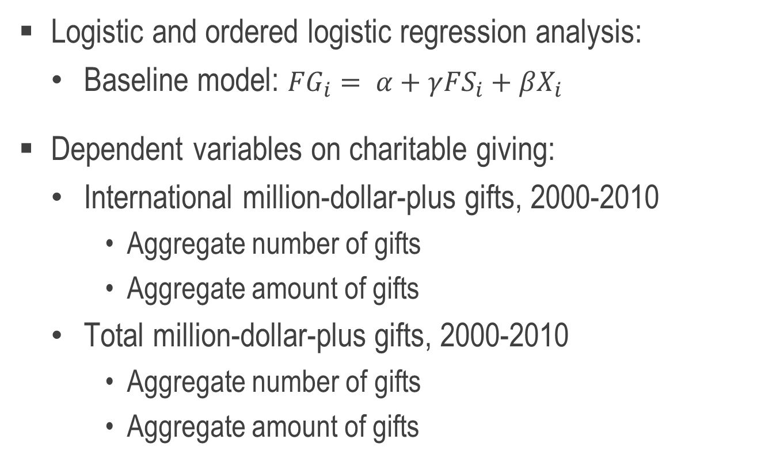
Methodology
Logistic and ordered logistic regression analysis:
Baseline model: ${FG}_{i}= α+γ{FS}_{i}+βX_{i}$
Dependent variables on charitable giving:
International million-dollar-plus gifts, 2000-2010
Aggregate number of gifts
Aggregate amount of gifts
Total million-dollar-plus gifts, 2000-2010
Aggregate number of gifts
Aggregate amount of gifts

Slide 8
Methodology
Independent variables on financial performance:
Foreign sales
Company size (revenue, assets, employees)
Profitability (net return on assets)
Financial risk (total debt to asset ratio)
Key control variables on company characteristics:
Industry
Reported R&D and advertising
Structure of corporate philanthropy

Slide 9
2012 Fortune 200 Company Profile
Charitable Giving | Average | Range
Number of Aggregate Million-Dollar-Plus Gifts (2000-2010, N = 200)
All Gifts | 15 | 0 - 157
Gifts to International Causes | 2 | 0 - 28
Amount of Aggregate Million-Dollar-Plus Gifts (2000-2010, N = 200) (inflation adjusted to 2011 dollars)
All Gifts | $170 million | 0 - $20 billion
Gifts to International Causes | $13 million | 0 - $820 million

Slide 10
2012 Fortune 200 Company Profile
Financial Performance (FY2002) | Average
Company Size
Total Revenues (in 2011 dollars) | $29.7 billion
Total Assets (in 2011 dollars) | $84 billion
Number of Employees | 80,338
Profitability
Net Return on Assets (ROA) | 2.6%
Financial Risk
Total Debt to Asset Ratio | 68.2%
Foreign Operations
Foreign Sales (in 2011 dollars) | $8.6 billion

Slide 11
Regression Results: International MDL Gifts from 2012 Fortune 200 Companies (2000-2010)
 | Aggregate # of Gifts | Aggregate $ of Gifts
Foreign Sales (Reference category: FY2002 Foreign Sales < 10% of total sales)
FY2002 Foreign Sales: 10-29% of total sales | 1.598** (0.725) | 1.813** (0.708)
FY2002 Foreign Sales: 30-49% of total sales | 2.636*** (0.811) | 2.567*** (0.795)
FY2002 Foreign Sales: 50% or more of total sales | 2.742*** (0.838) | 2.702*** (0.828)
Notes: The coefficients on key indicators are reported in the table. Standard errors are presented in parentheses.
The sample size is 143 companies. *** p < 0.01 ** p < 0.05 * p < 0.10

Slide 12
Regression Results: All MDL Gifts from 2012 Fortune 200 Companies (2000-2010)
 | Aggregate # of Gifts | Aggregate $ of Gifts
Foreign Sales (Reference category: FY2002 Foreign Sales < 10% of total sales)
FY2002 Foreign Sales: 10-29% of total sales | -0.157 (0.610) | 0.074 (0.631)
FY2002 Foreign Sales: 30-49% of total sales | 0.090 (0.542) | -0.312 (0.552)
FY2002 Foreign Sales: 50% or more of total sales | 0.422 (0.625) | 0.374 (0.553)
Notes: The coefficients on key indicators are reported in the table. Standard errors are presented in parentheses.
The sample size is 143 companies. *** p < 0.01 ** p < 0.05 * p < 0.10

Slide 13
Regression Results: MDL Gifts from 2012 Fortune 200 Companies (2000-2010)
 | International MDL Gifts |  | All MDL Gifts
Financial Indicators (FY2002) | Aggregate # of Gifts | Aggregate $ of Gifts | Aggregate # of Gifts | Aggregate $ of Gifts
Total Revenue (in log form) | 0.230 (0.325) | 0.310 (0.335) | 0.147 (0.366) | -0.159 (0.327)
Total Assets (in log form) | 1.531*** (0.348) | 1.497*** (0.368) | 1.281*** (0.320) | 1.689*** (0.343)
Net Return on Assets (ROA) | 3.583** (1.736) | 4.492** (2.178) | 6.771*** (1.993) | 7.744** (3.116)
Debt to Asset Ratio | -4.602*** (1.478) | -4.527*** (1.494) | -1.899 (1.184) | -1.931 (1.228)
Advertising Reported Dummy | 0.061 (0.485) | -0.240 (0.470) | 1.281** (0.502) | 1.703*** (0.440)
R&D Reported Dummy | -0.454 (0.590) | -0.469 (0.549) | 0.417 (0.449) | 0.420 (0.476)
Notes: The coefficients on key indicators are reported in the table. Standard errors are presented in parentheses.
The sample size is 143 companies. *** p < 0.01 ** p < 0.05 * p < 0.10

Slide 14
Findings from Alternative Models
Results were fairly consistent across model types (OLS, Poisson, Tobit, negative binomial)
Changing the fiscal year of control variables did not significantly affect model
Controlling for whether company was on Fortune 500 in 2002 did not change results

Slide 15
Additional Findings on Corporate International Giving

Slide 16
Corporate International Giving
... % of total giving supported international initiatives
(n=27)
... % of international giving went to developing countries
(n=27)

Slide 17
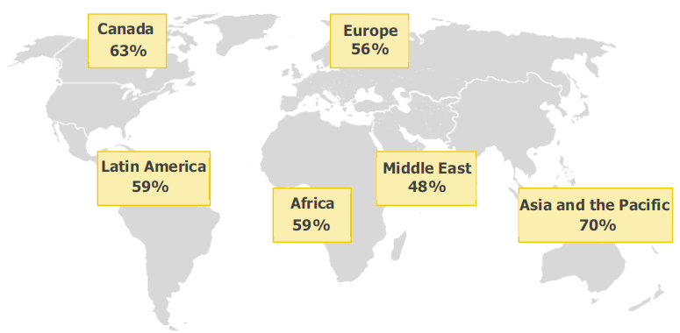
Which Regions Do Companies Support Outside of the U.S.?
(n=27 companies in the survey, % of companies donating)

Slide 18
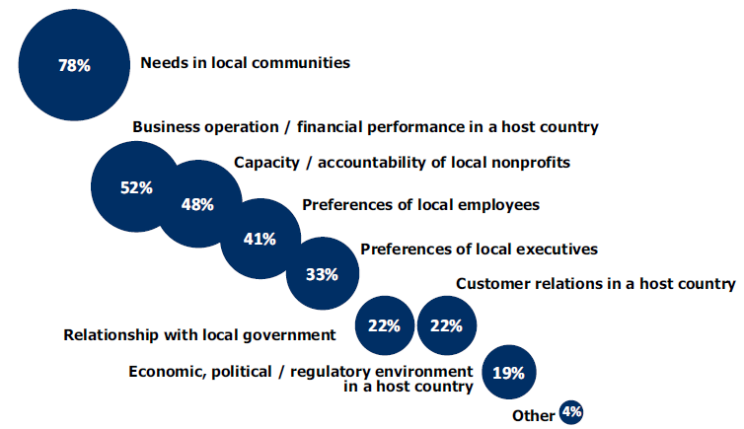
Which Host Country Factors Influence Foreign Corporate Giving?
(n=27 companies in the survey)

Slide 19
Future Outlook for Corporate International Giving
Resources needed:
“Vetting of nonprofits and facilitation of partnerships with international nonprofits”
“Employee engagement strategy”
“Benchmarking and research on best practices”
Future priorities:
Strengthen sustainable partnerships
Deepen evaluation

Slide 20
Thank You!
Indiana University Lilly Family School of Philanthropy
550 West North Street, Suite 301, Indianapolis, IN 46202
Improving Philanthropy to Improve the World
www.philanthropy.iupui.edu

